Slide 1
CS514L-Artificial Intelligence
Assignment 2
Search and Optimization
Team Members
CS25S002 - J ARJUN ANNAMALAI
CS24M106 - LOGESH .V

Slide 2
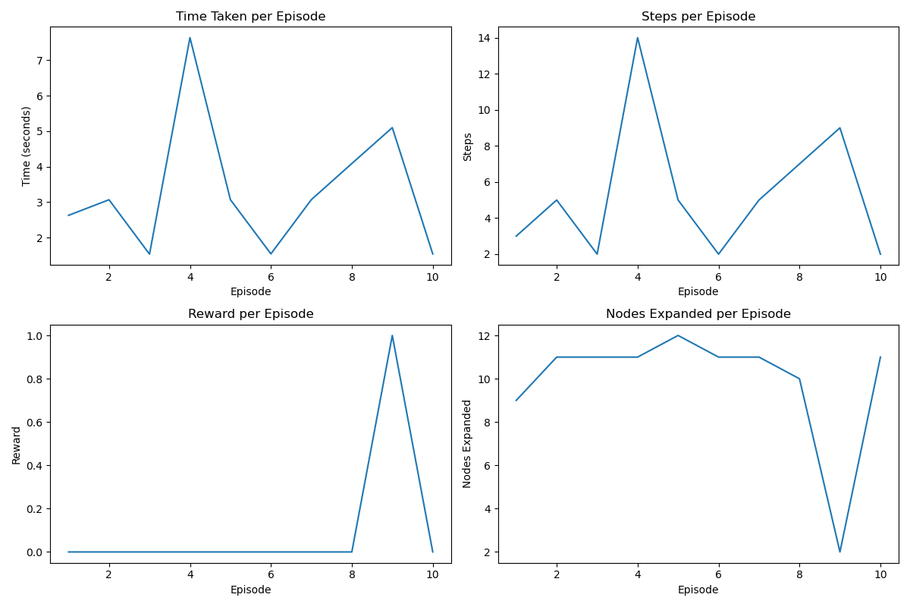
Branch and Bound
Environment: Frozen Lake
Heuristic function used: Lower bound estimate EU distance to goal
Used a priority queue to expand nodes with the lowest path cost, while pruning repeated states to efficiently find an optimal path.

Slide 3
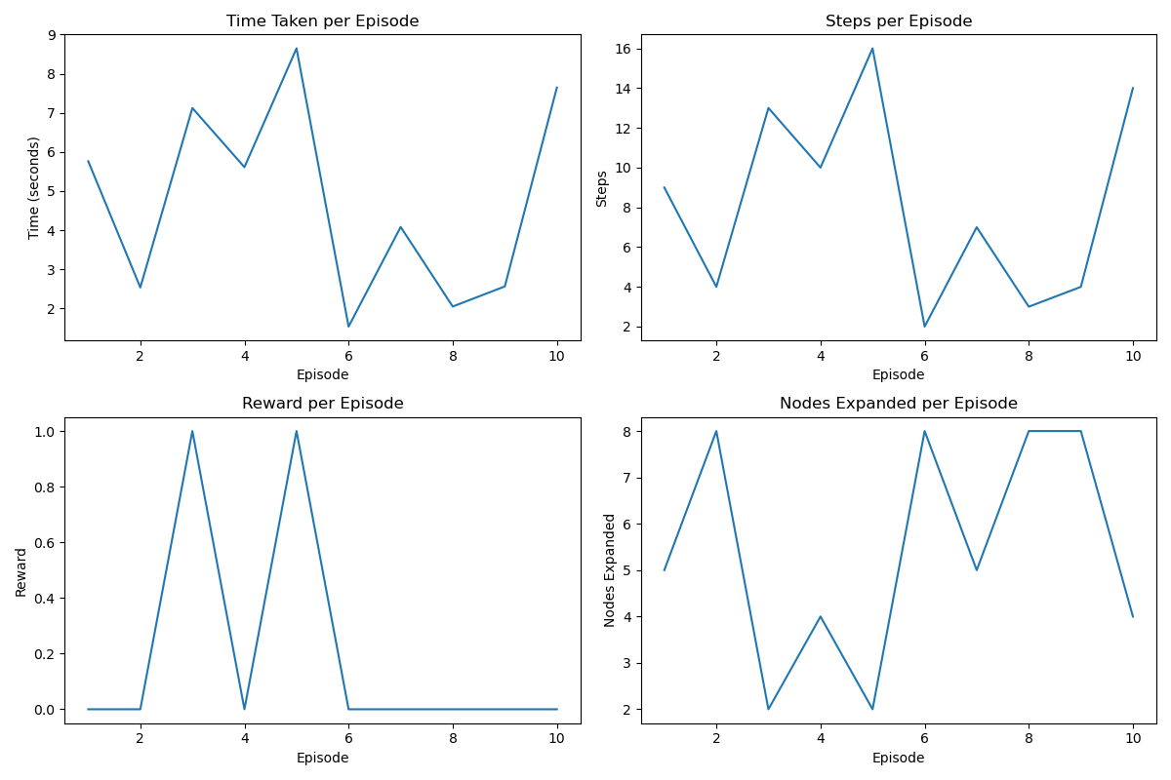
Iterative Deepening A*
Environment: Frozen Lake
Heuristic function used: Manhattan distance
Using the Manhattan distance heuristic, It iteratively increases the cost threshold while tracking node expansions and episode performance metrics.

Slide 4
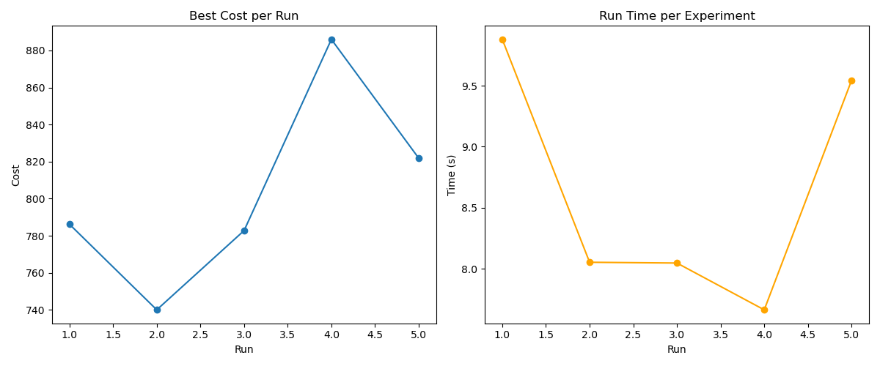
Hill Climbing
Environment: ant_colony_opt_TSP
Heuristic function used: lower Euclidean distance
Hill Climbing for TSP is implemented by randomly perturbing an initial route and accepting improvements based on a lower Euclidean distance.

Slide 5
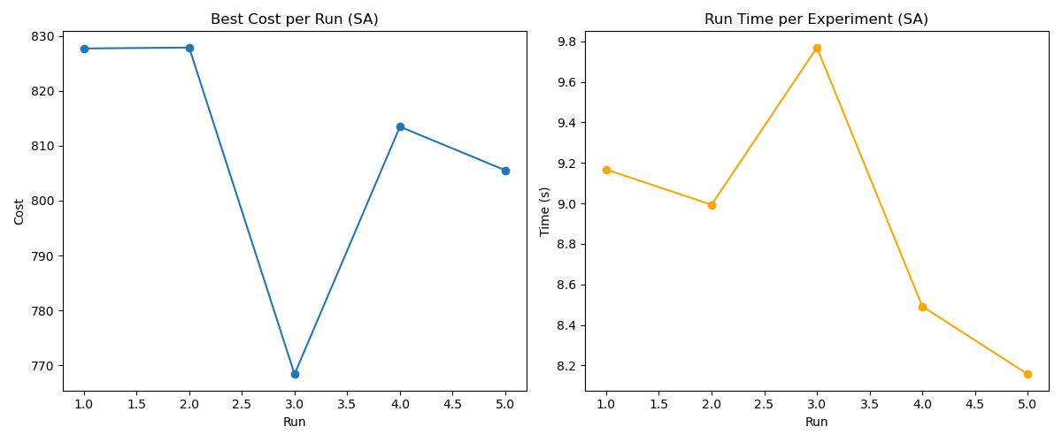
Simulated Annealing
Environment: ant_colony_opt_TSP
Heuristic function used: Euclidean route distance
Using a temperature-based acceptance criterion to probabilistically accept worse solutions, thereby exploring the solution space efficiently.

Slide 6
Thank You

